Slide 1
Design of RF & Microwave Systems
EEC 134 A&B
Lecture 7: Building Blocks of RF Systems
– Antennas
Xiaoguang “Leo” Liu
Assistant Professor
School of Electrical and Computer Engineering
Tel: 530-289-6367
lxgliu@ucdavis.edu
http://ucdart.net

Slide 2

Antenna
An antenna converts voltage/current signals into electromagnetic radiation (E and H fields), and vice versa
Guided wave ←→ Radiated wave
The plural form of antenna—in electrical engineering—is antennas, at least in the US and Canada
http://grammarist.com/usage/antennae-antennas/
Notes:
Can also be viewed as an impedance transformer between the system impedance Z₀ (50 Ω) and the medium impedance (377 Ω for free space).
http://simpleicon.com/antenna-2.html
Use an HFSS simulation animation

Slide 3
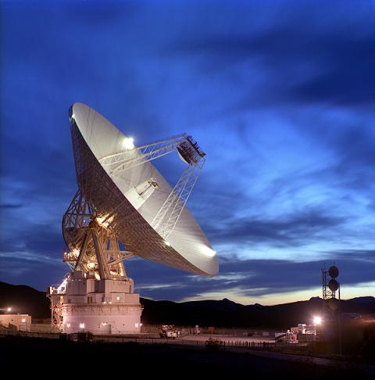
Antenna Examples
A 70-meter dish antenna. Part of NASA's Jet Propulsion Laboratory (JPL) communication system.

Slide 4
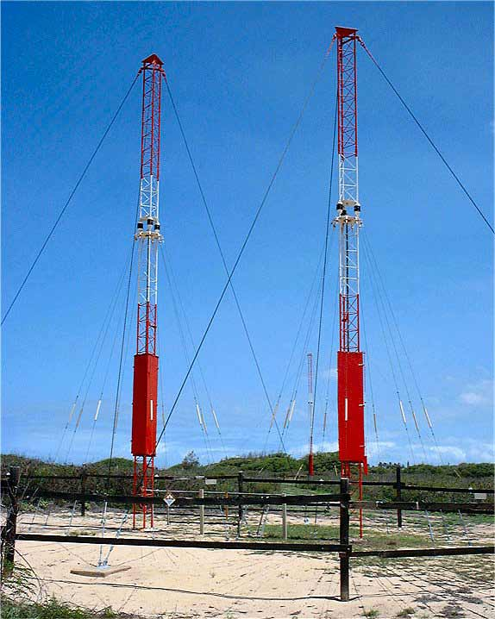
Antenna Examples
The WWVH 15 MHz Directional Transmitting Array (AM radio)

Slide 5
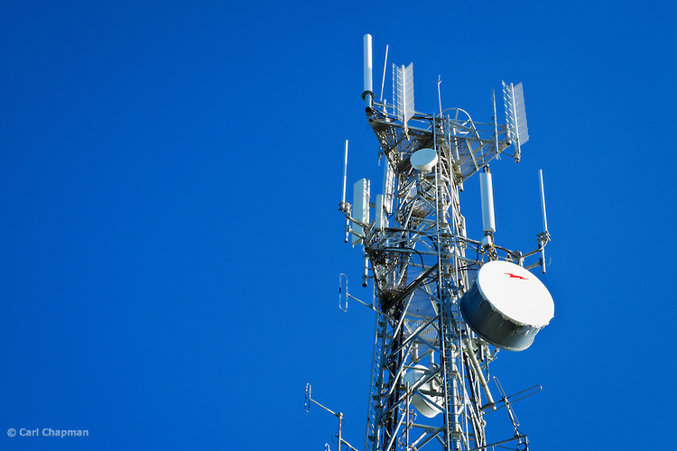
Antenna Examples
Antennas on a typical cellular base station

Slide 6
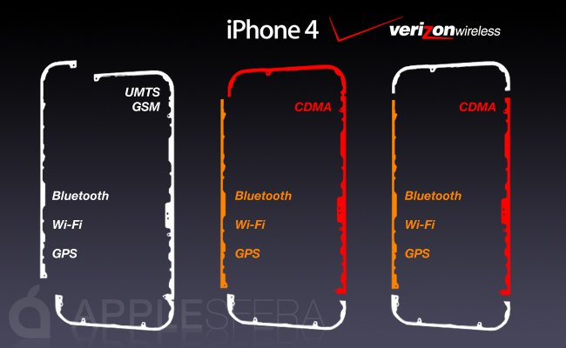
iPhone Antennas

Slide 7
Basic Antenna Concepts and Specifications

Slide 8
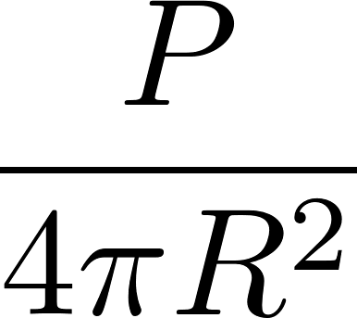
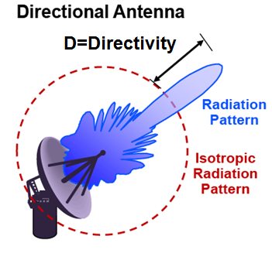
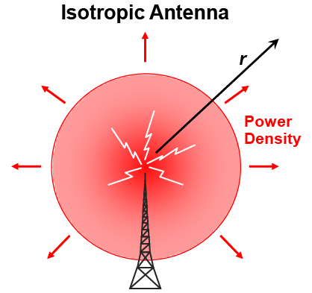
Isotropic vs. Directive Antenna
An isotropic radiator/antenna radiates uniformly to all directions in 3D space
Power density at distance R is
No real isotropic antenna exists; All antennas radiate stronger in some directions than others
Notes:
It can be proven that a linear polarized antenna can not have an isotropic pattern; further refer to the hairy ball theorem
http://arxiv.org/pdf/physics/0312023.pdf
http://en.wikipedia.org/wiki/Isotropic_radiator

Slide 9
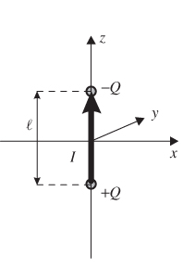
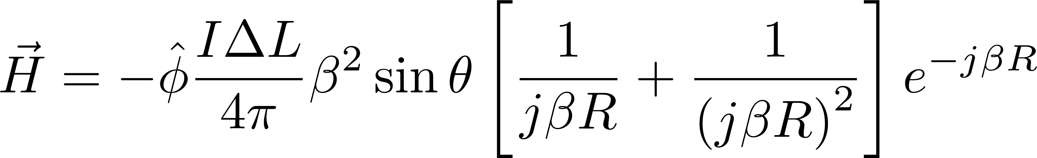
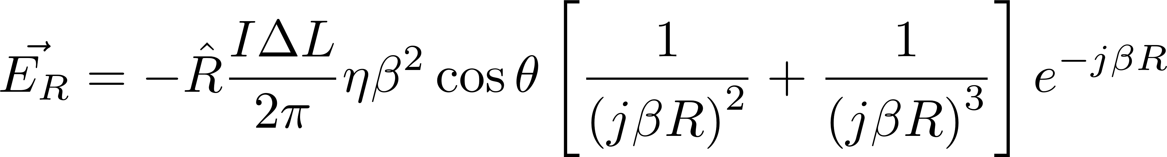
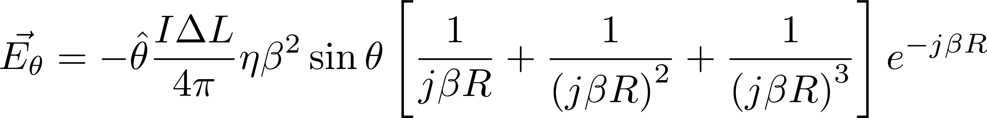
The Hertzian Dipole
The Hertzian dipole is the simplest, and rather idealized, radiating element. It consists of a small current that oscillates between two charge reservoirs.
Here I represents a sinusoidal current of magnitude I; its phasor representation is simply I
Exact mathematical expressions of the electric and magnetic fields can be derived for the Hertzian dipole
https://www.safaribooksonline.com/library/view/rf-and-microwave/9781118349571/c07_level1_3.xhtml
http://whites.sdsmt.edu/classes/ee382/notes/382Lecture32.pdf

Slide 10
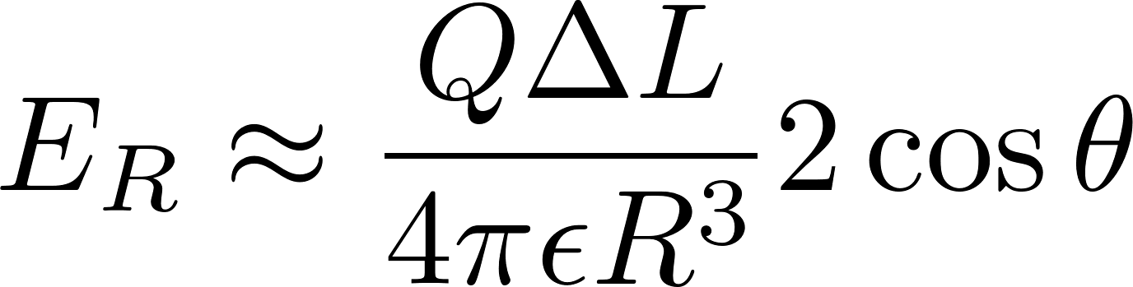
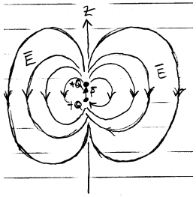
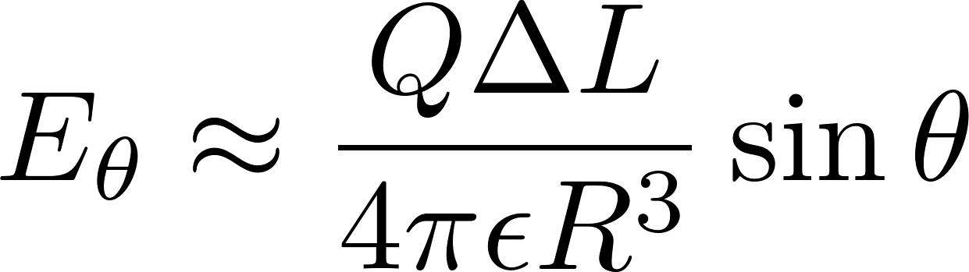
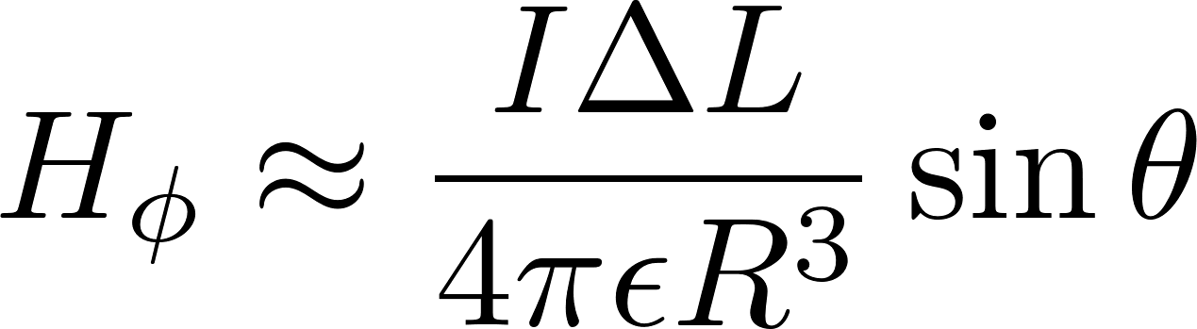
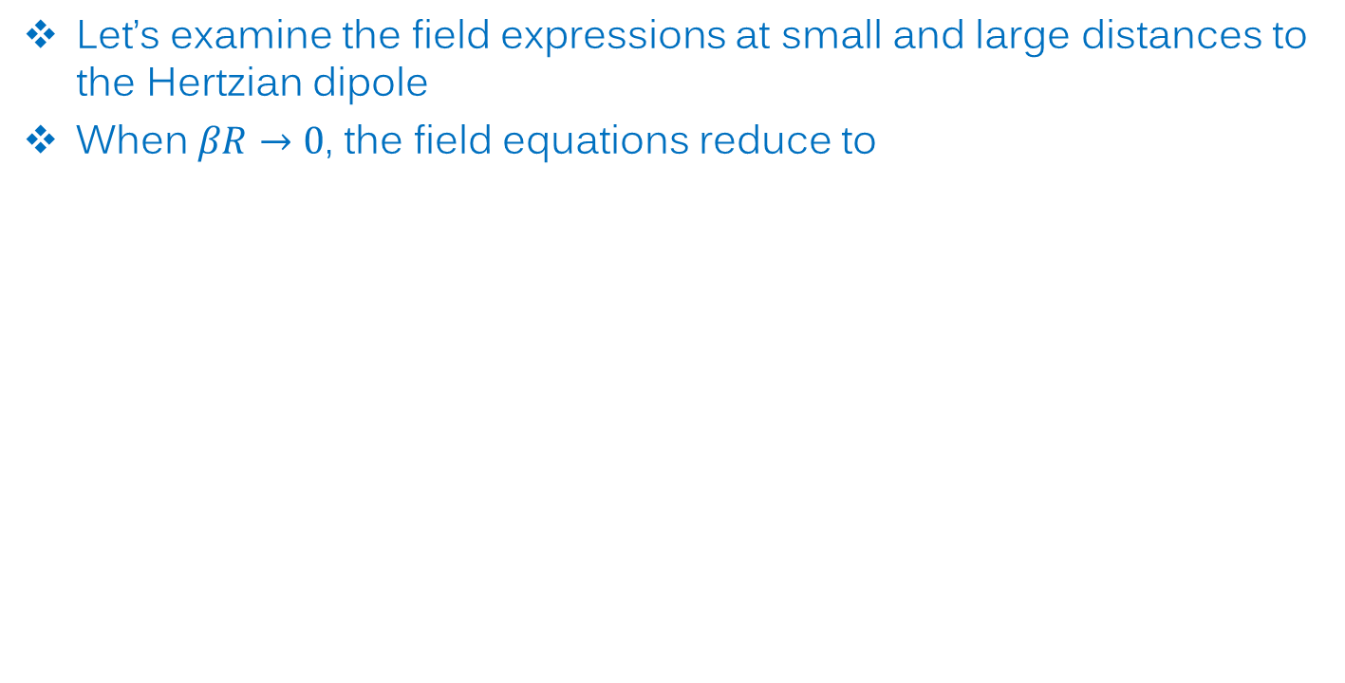
Near Field
Let’s examine the field expressions at small and large distances to the Hertzian dipole
When $βR→0$, the field equations reduce to
Similar to the electric field of a static electric dipole
Similar to the field of a small current
http://whites.sdsmt.edu/classes/ee382/notes/382Lecture32.pdf

Slide 11
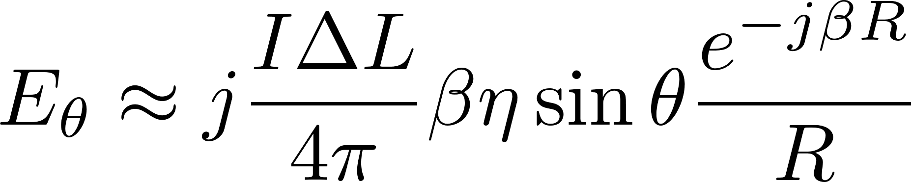
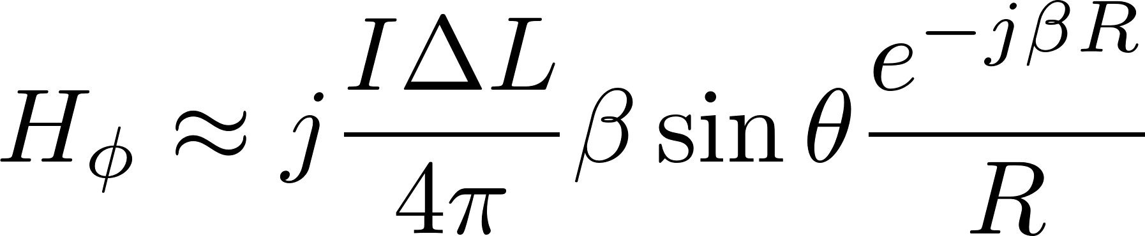
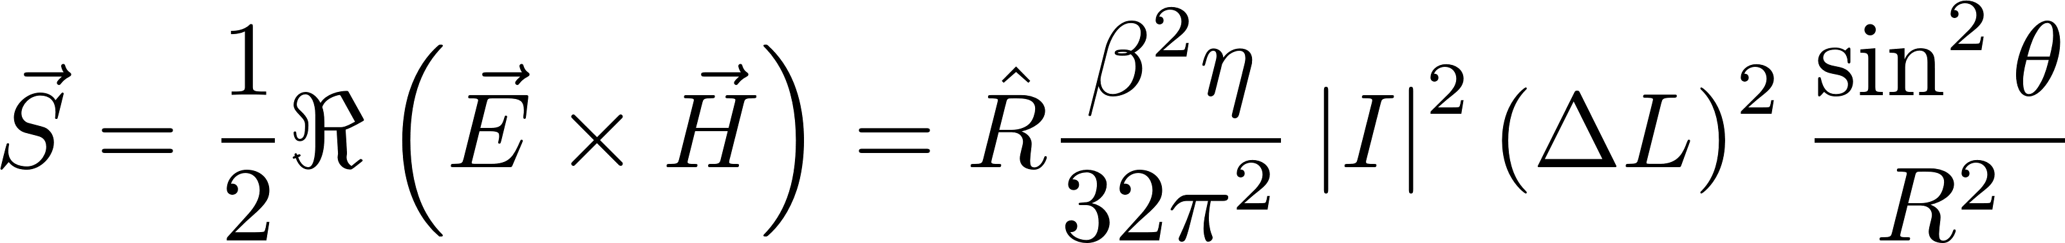
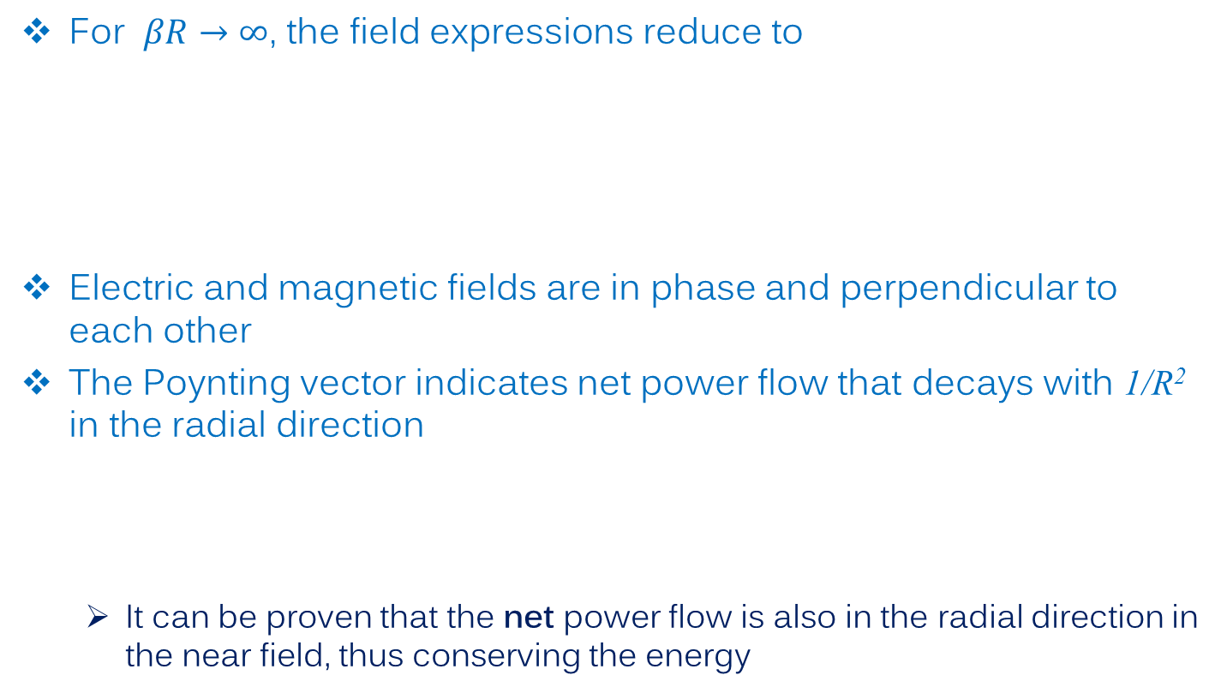
Far Field
For $βR→∞$, the field expressions reduce to
Electric and magnetic fields are in phase and perpendicular to each other
The Poynting vector indicates net power flow that decays with 1/R² in the radial direction
It can be proven that the net power flow is also in the radial direction in the near field, thus conserving the energy
http://www.hep.princeton.edu/~mcdonald/examples/hertzian_momentum.pdf

Slide 12
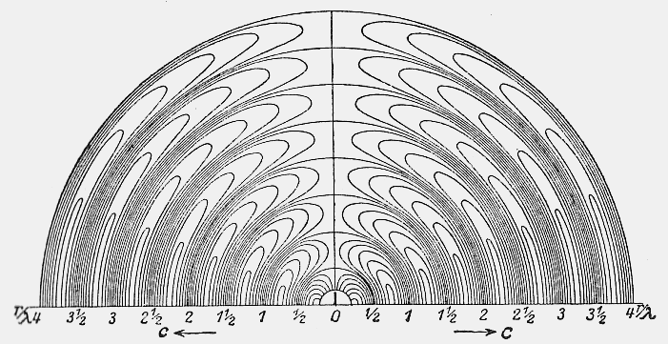
Hertzian Dipole Field
A depiction of the field distribution of a Hertzian dipole by Hertz himself
The pattern of electromagnetic waves radiated by an ideal electric dipole, as calculated by Heinrich Hertz and published in 1889. The axis of the dipole is vertical. Only the upper half of the pattern is shown, the lower half being symmetrical. The scale along the bottom is distance from the dipole in wavelengths. The diagram shows the pattern at one instant of time. After one cycle of oscillation the whole pattern radiates outward one wavelength on the scale shown.
http://www.newscotland1398.net/nfld1901/marconi-nfld.html

Slide 13
Hertzian Dipole as the Building Block of All Antennas
A Hertzian dipole is composed of an idealized infinitesimally small sinusoidal current
Any other antenna can be thought of as a distribution of such small currents. Therefore, the radiation field of any antenna could be found by integrating the field of a Hertzian dipole over the current distribution.
Antennas are linear and reciprocal
Although this is conceptually easy to understand, it can be quite difficult to carry out in practice because the current distribution on an antenna may not be easily determined.

Slide 14
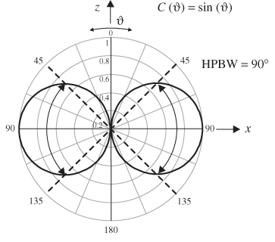
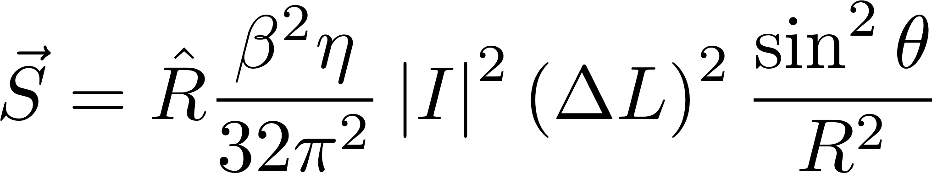
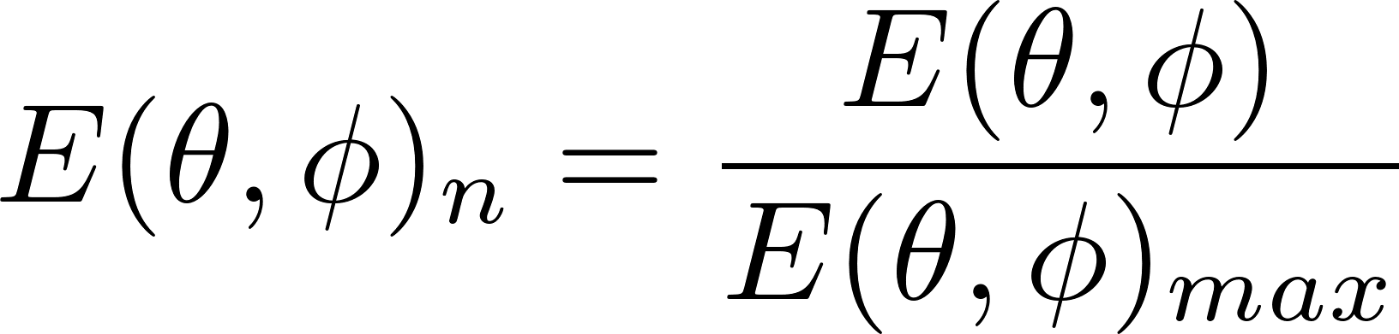
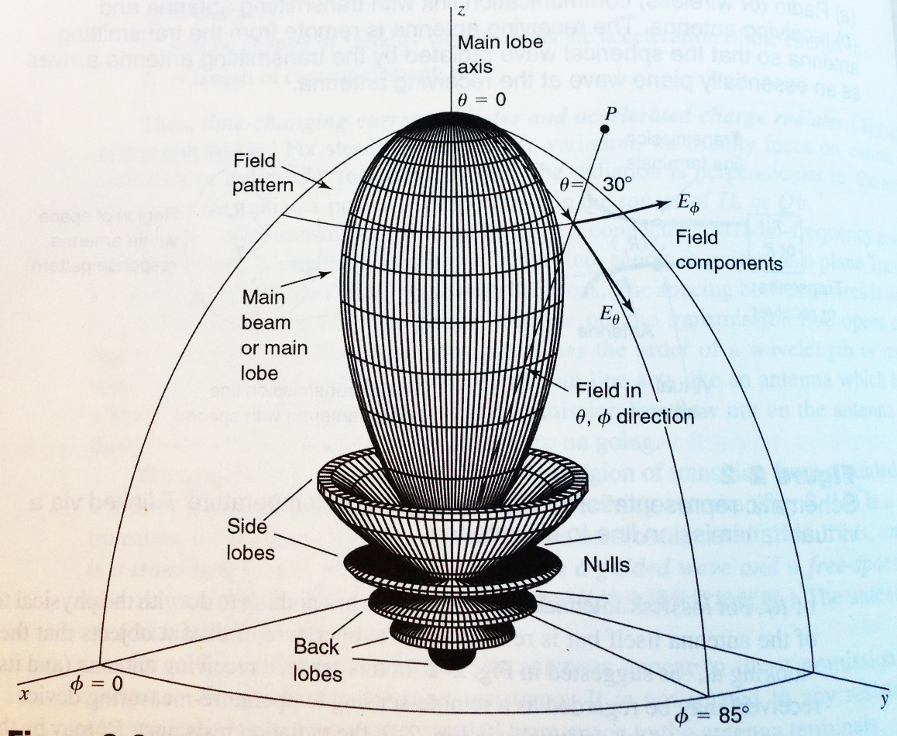
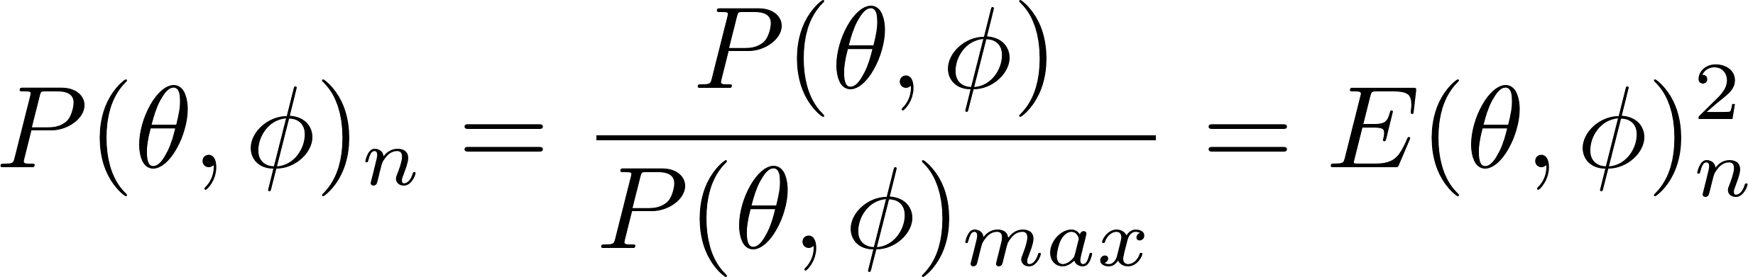
Antenna Pattern
Examining the far-field expressions for the Hertzian dipole, we see that the radiation power density is not the same in all directions
All antennas do not radiate the same in all directions.
Antenna pattern describes the relative strength of radiation with angle
In terms of
Fields
Power
https://www.safaribooksonline.com/library/view/rf-and-microwave/9781118349571/c07_level1_3.xhtml
Antennas, For All Applications, 3rd Ed. John D. Kraus

Slide 15
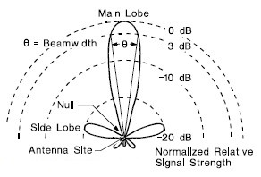
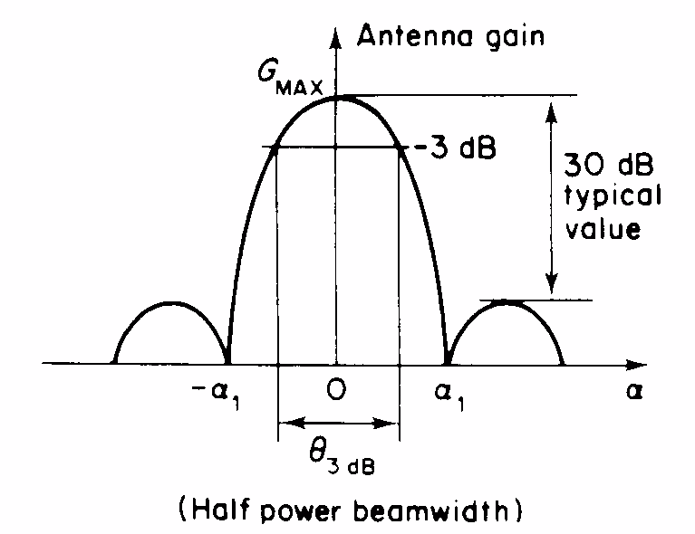
Beamwidth
A concept that can be used quantify how directive an antenna is is the beamwidth
A popular quantity is the “3-dB beamwidth”, aka “half-power beamwidth (HPBW)” is the angle within which the radiated power density is within half of the maximum radiated power density
Pattern plotted in
polar coordinate
Pattern plotted in Cartesian coordinate

Slide 16
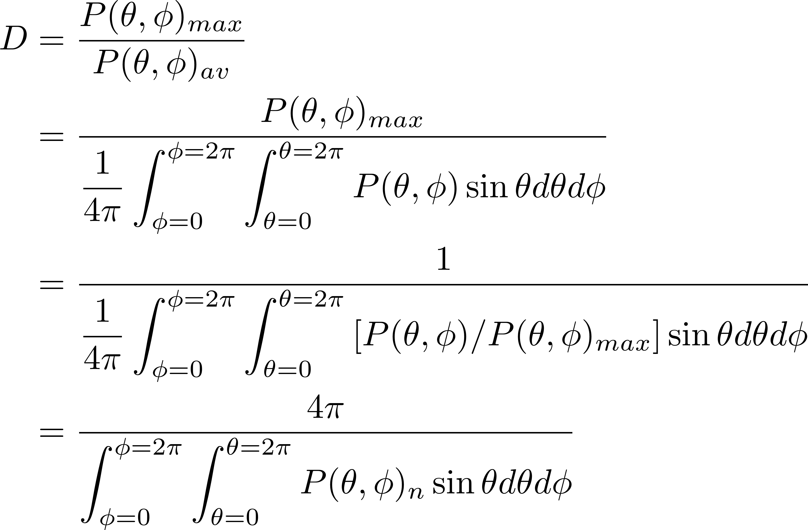
Directivity
Directivity is a more formal and accurate measure of how directive an antenna is.
Directivity can be calculated from the antenna pattern

Slide 17
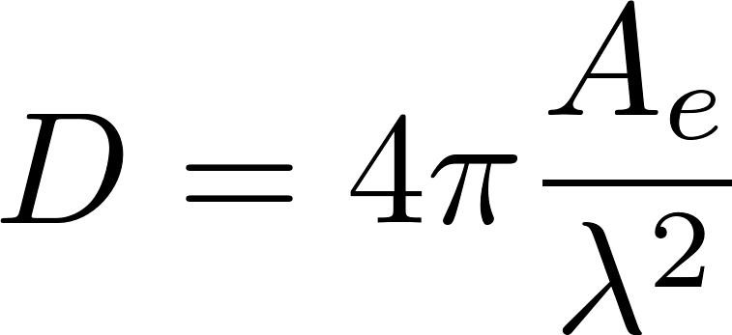
Directivity
Directivity is largely determined by the physical size of the antenna
It is also important to point out that the antenna pattern and directivity is greatly affected by its surroundings. In general, power tends to radiate more into regions of higher dielectric constant
Effective aperture,
usually comparable with the largest physical dimension of the antenna

Slide 18
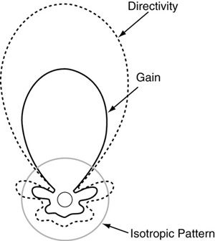
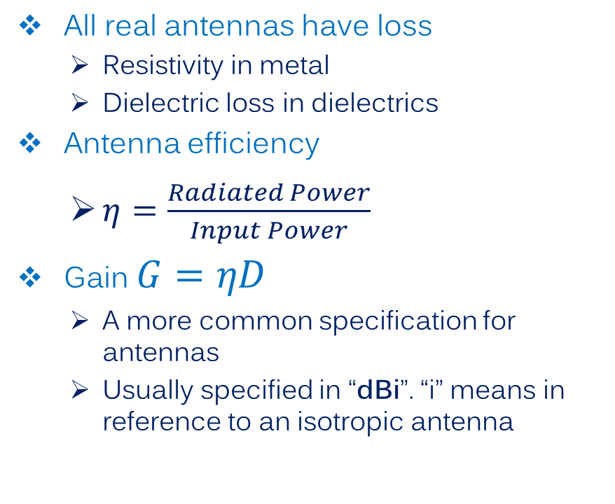
Gain
All real antennas have loss
Resistivity in metal
Dielectric loss in dielectrics
Antenna efficiency
$η=\frac{Radiated Power}{Input Power}$
Gain $G=ηD$
A more common specification for antennas
Usually specified in “dBi”. “i” means in reference to an isotropic antenna
Gain is specified relative to a lossless isotropic antenna; no real power gain
http://www.digikey.com/en/articles/techzone/2011/mar/understanding-antenna-specifications-and-operation

Slide 19
Common Antenna Designs

Slide 20
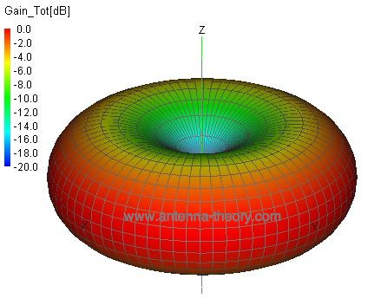
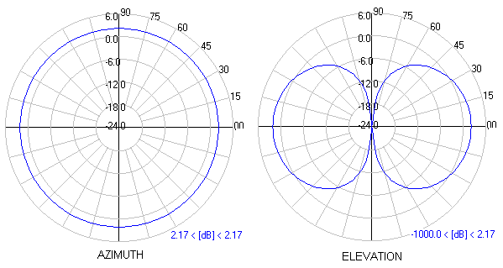
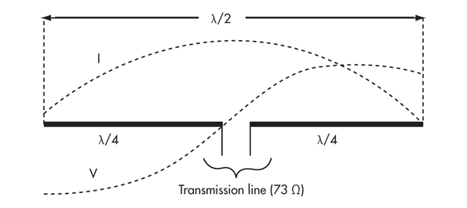
Dipole Antenna
A dipole antenna consists of two radiating arms.
A dipole antenna is often characterized as “omni-directional” as it radiates equally in the horizontal plane (perpendicular to the two radiating arms).
The 3D radiation pattern of a dipole takes on a donut shape
Null along the direction of the arms
3D Pattern for a λ/2 dipole

Slide 21
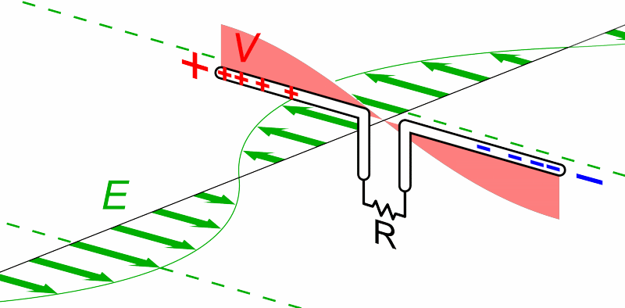
Dipole Antenna

Slide 22
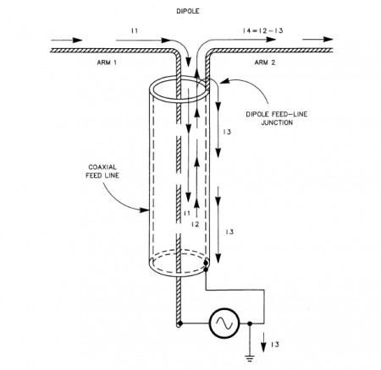
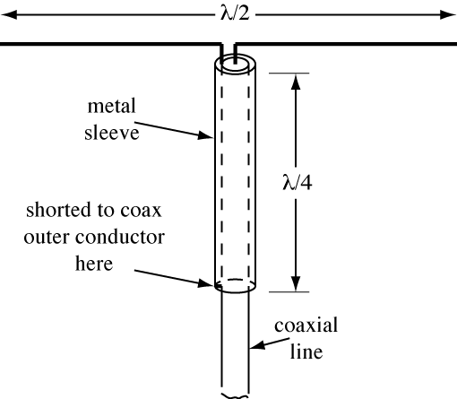
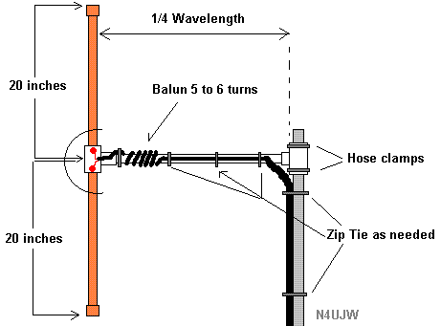
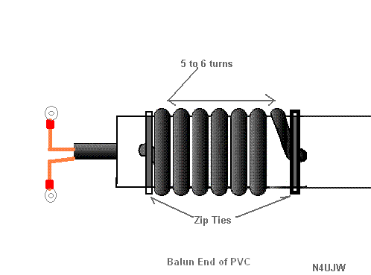
Dipole Antenna
The dipole is a balanced antenna
If an unbalanced transmission line, such as a coax line, is used, it is best to insert a BALUN between the transmission line and the antenna
λ/4 choke balun
1:1 current mode balun

Slide 23
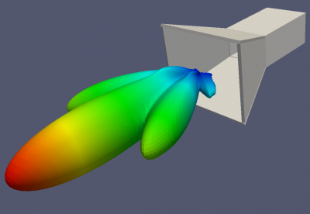
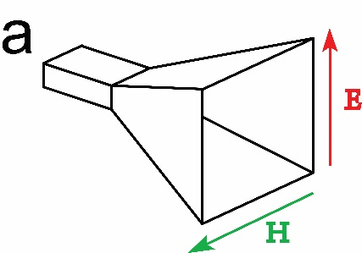
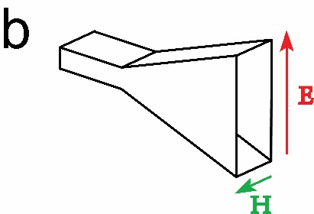
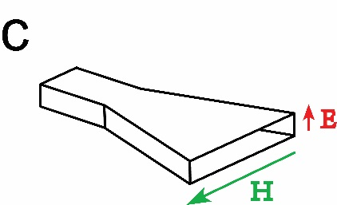
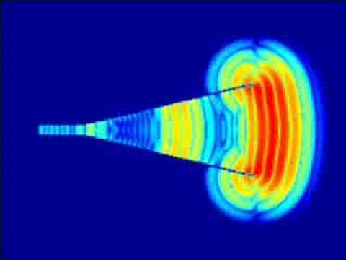
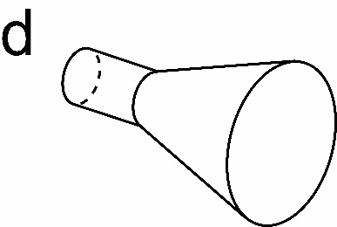
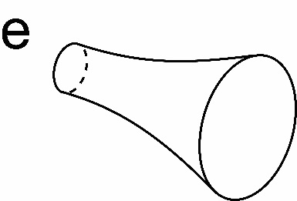
Horn Antennas
A horn antenna is made by gradually opening up a hollow metallic waveguide
Horn antennas are relatively wideband and high gain
http://en.wikipedia.org/wiki/Horn_antenna

Slide 24
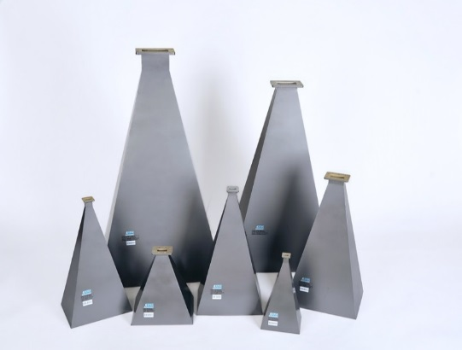
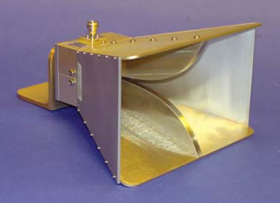
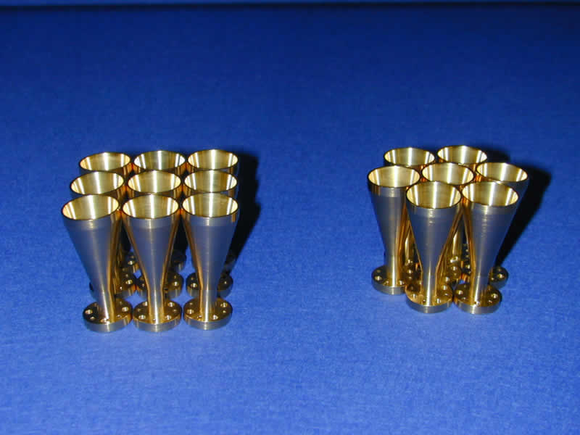

Horn Antenna Examples
Rectangular Horns
Ridge Horns for wider bandwidth
Corrugated Horns for wider bandwidth and smaller sidelobes
Cylindrical Horns

Slide 25



Microstrip Patch Antenna
Planar metal patch as radiator
Compatible with PCB technology
Each to fabricate
Easy to feed
Planar microstrip feed
Vertical probe feed

Slide 26
Antenna Arrays

Slide 27
Antenna Array
Multiple antennas can be arranged in an array to give larger gain (narrower) beam
Effectively increasing the total area
Received power ~ N²
Point of Observation
Point of Observation
λ/2
S
o
u
r
c
e
:
R
.
M
.
O
’
D
o
n
n
e
l
l
,
h
t
t
p
:
/
/
o
c
w
.
m
i
t
.
e
d
u
/
r
e
s
o
u
r
c
e
s
/
r
e
s
-
l
l
-
0
0
1
-
i
n
t
r
o
d
u
c
t
i
o
n
-
t
o
-
r
a
d
a
r
-
s
y
s
t
e
m
s
-
s
p
r
i
n
g
-
2
0
0
7
/

Slide 28

Antenna Array
Pattern for linear array of isotropic antennas
Pattern for general antenna array
Array Factor (AF)

Slide 29

Phased Array Antenna
Electronically scanned array (ESA)
Fast beam scanning -> tracking multiple targets
No moving parts -> High reliability
Graceful degradation
S
o
u
r
c
e
:
R
.
M
.
O
’
D
o
n
n
e
l
l
,
h
t
t
p
:
/
/
o
c
w
.
m
i
t
.
e
d
u
/
r
e
s
o
u
r
c
e
s
/
r
e
s
-
l
l
-
0
0
1
-
i
n
t
r
o
d
u
c
t
i
o
n
-
t
o
-
r
a
d
a
r
-
s
y
s
t
e
m
s
-
s
p
r
i
n
g
-
2
0
0
7
/
Notes:
The beam direction can be steered by changing the relative phase between elements in an array

Slide 30


AM Broadcast Array
http://tf.nist.gov/stations/wwvhtour.html
http://www.embedded.com/print/4011121

Slide 31


Very Large Array (VLA)

Slide 32





Antenna Array Examples
Patch Antennas
Feed Network

